Slide 1
GEOG 392/676 GIS Programing Lab5
Zhenlei Song, Ph.D Student
Department of Geography
Email: songzl@tamu.edu
Office: CSA 301F

Slide 2
Lab 5 Tasks
Turn the python script from Lab4 into a Tool
Specify the garage name & buffer radius from user input (required).
Use `searchCursor` to select the specific garage
Turn such tool into an ArcGIS Pro Toolbox
Make success and error outputs via arcpy
Success when putting in proper building name
Error when the input building name doesn’t exist

Slide 3
Reading Before Lab
Creating a console tool
https://github.com/TAMUCIDI/GEOG-392-GIS-Programming/blob/main/Labs/Lab05/Lab05-pre01.md
Creating a ArcPy Toolbox
https://github.com/TAMUCIDI/GEOG-392-GIS-Programming/blob/main/Labs/Lab05/Lab05-pre02.md

Slide 4
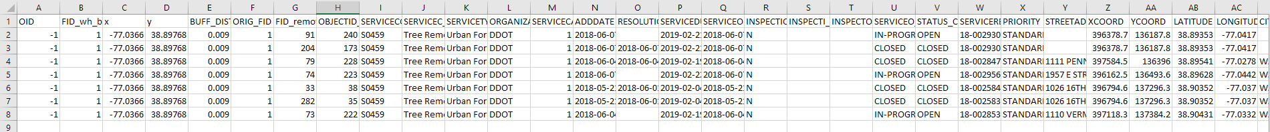
Preparation
Download “Lab5_data.zip” from Github: Link
Unzip “Lab5_data.zip”
Campus.gdb
Garages.csv

Slide 5
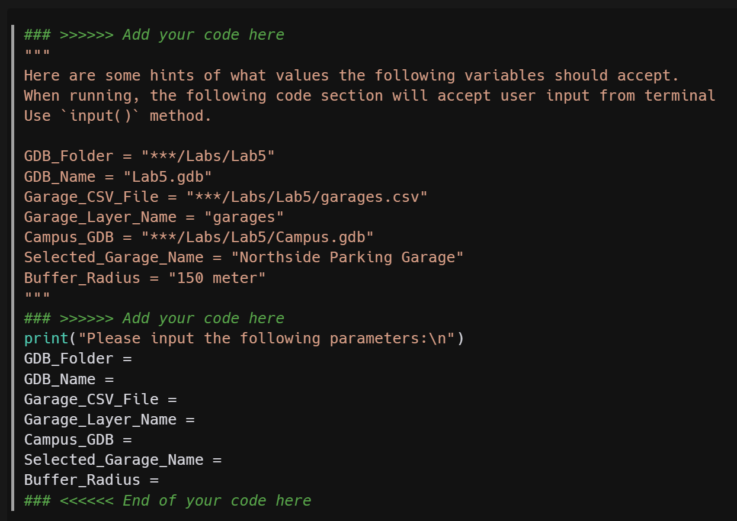
Part 1. ArcPy Tool
Step 1. Accept Parameters from User Input
Use `input()` func to accept user input from terminal.
Only `garage_name` and `buffer_radius` are required to be accepted from user input.
The rest items are optional, that means you can assign them with fixed values like in Lab4.

Slide 6
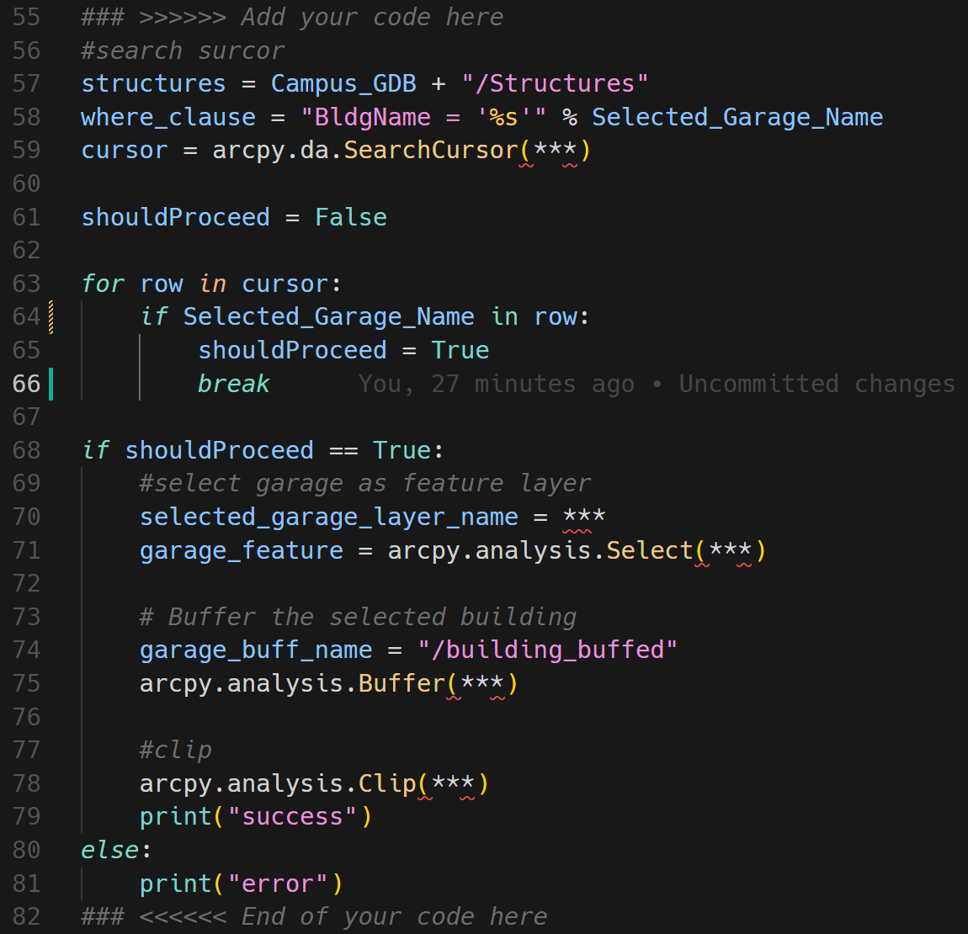
Part 1. ArcPy Tool
Step 2. Determine Whether the selected building exists
Use `arcpy.da.SearchCursor` func to create a search cursor.
Use a loop to match rows in a cursor.
Within each loop, determine if the search cursor found the value that user entered.
If so, proceed to the next step.
If not, exit with error message.

Slide 7
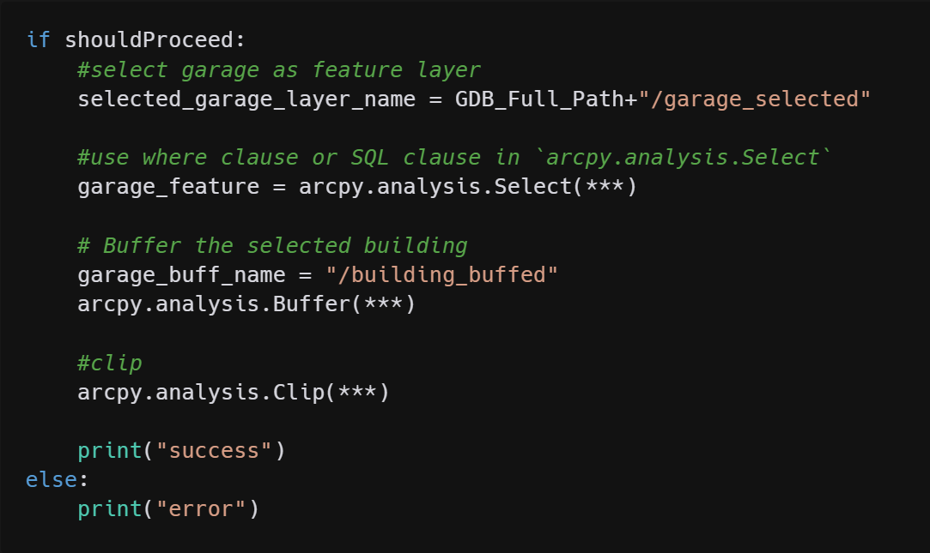
Part 1. ArcPy Tool
Step 3. Buffer & Clip
Select the garage with the name entered.
Buffer on the selected sub-feature class.
Clip the structures on the selected garage buffer.

Slide 8
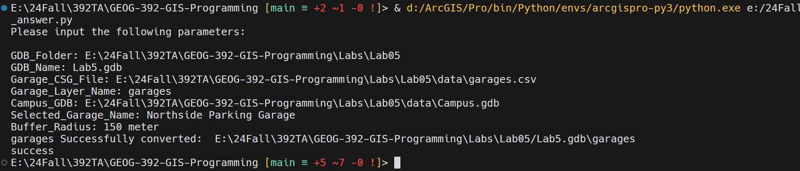
Part 1. ArcPy Tool
Result

Slide 9
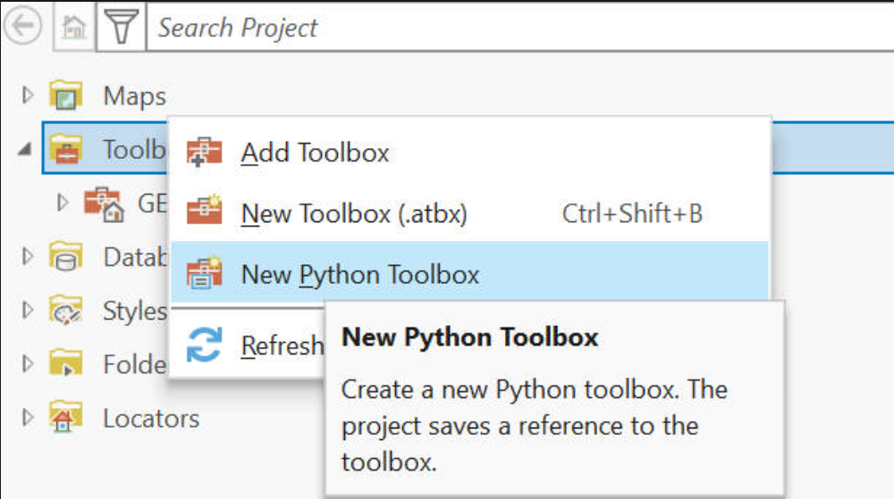
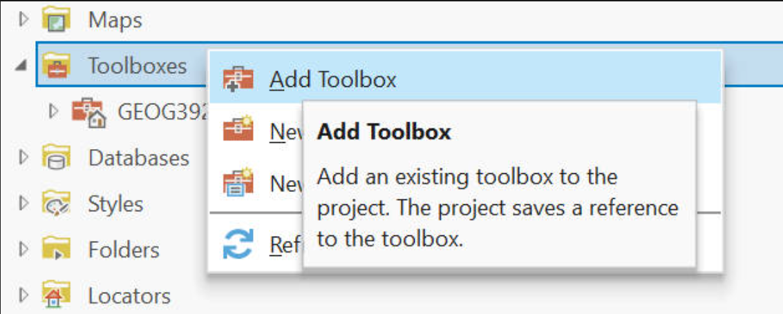
Part 2. ArcPy Toolbox
Step 1. Create or Add a toolbox
Notes:
New python toolbox will ask you to generate a new XXX.pyt file with default templates.
Add toolbox can import your own XXX.pyt.

Slide 10
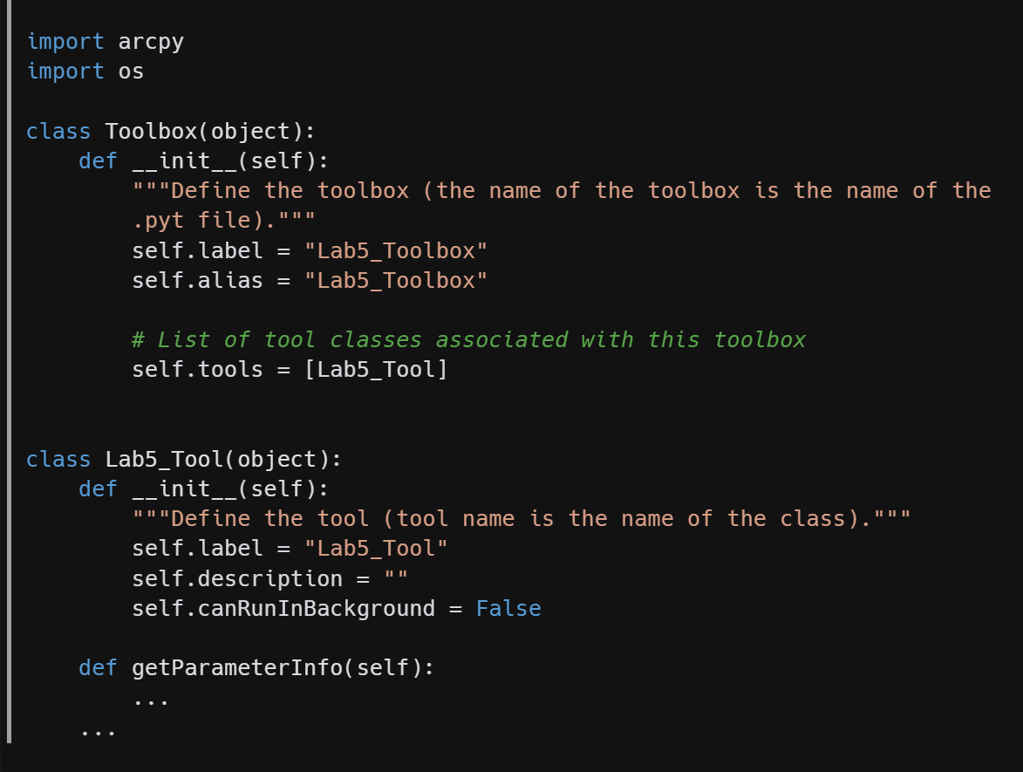
Part 2. ArcPy Toolbox
Step 2. Toolbox Class
2 classes: `Toolbox` and `Tool`
Toolbox:
In __init__ func, it needs to declare the name of the `tool` class in the `self.tools`.
Tool:
Next page
Notes:
In a XXX.pyt file, there need to be 2 classes at least.
The toolbox class.
The Tool class.
In the init function of toolbox class, it needs to declare the name of the tool class like we do here in the template.

Slide 11
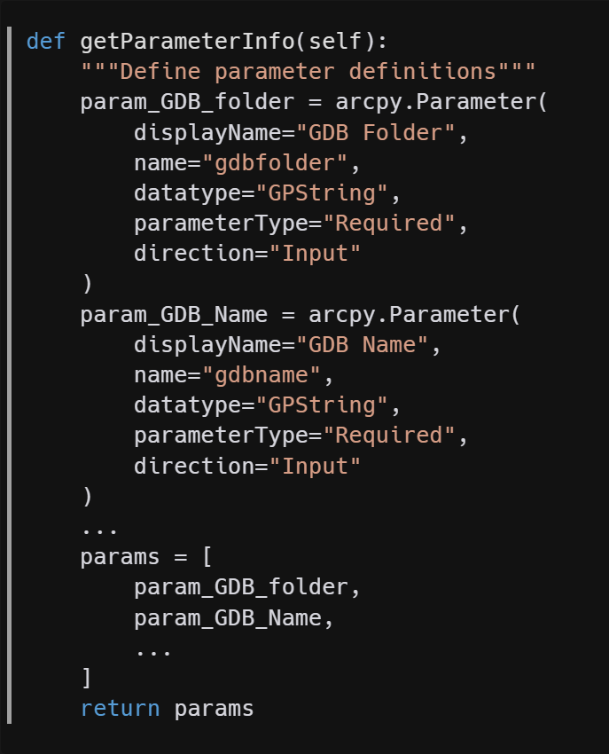
Part 2. ArcPy Toolbox
Step 3-1. Tool Class – getParameter()
3 functions are required in the `Tool` class:
`__init__()`
`getParameter()`
`execute()`
Use `arcpy.Parameter()` method in the `getParameterInfo()`.
`getParameterInfo()`. API Link: https://pro.arcgis.com/en/pro-app/latest/arcpy/geoprocessing_and_python/defining-parameter-data-types-in-a-python-toolbox.htm
This doc is very very very very important. Be careful with the parameterType
Notes:
I only show 2 parameters in the screenshot: GDB Folder and GDB name.
Please remember, only garage name and buffer radius are required parameters.
You can choose to add more parameters here.
But please make sure you set the parameter settings correctly.
For example, buffer radius data’s parameter type could be float. Look through the DOC to find out how to set it up.

Slide 12
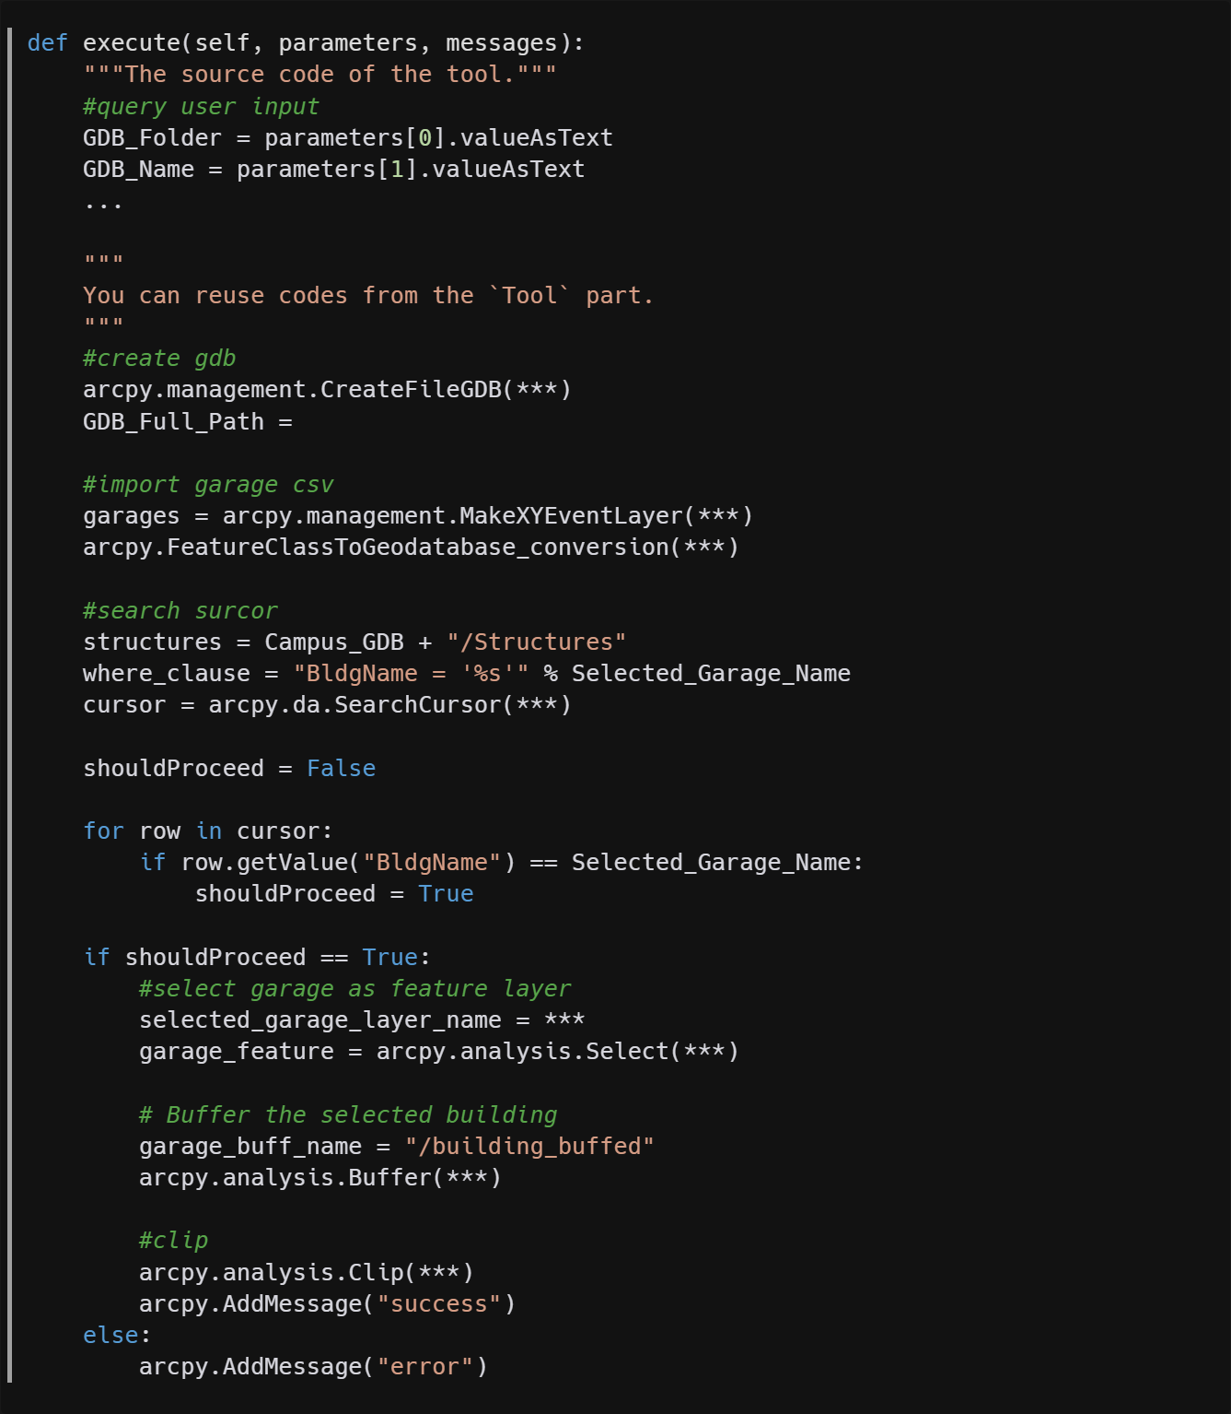
Part 2. ArcPy Toolbox
Step 3-2. Tool Class – execute()
Accept values from parameters in the getParameter() func.
Re-use most codes from Part1 to do the select, buffer, and clip operations.
Except for the messages. Instead of use `print()`, use `arcpy.AddMessage()` here.

Slide 13
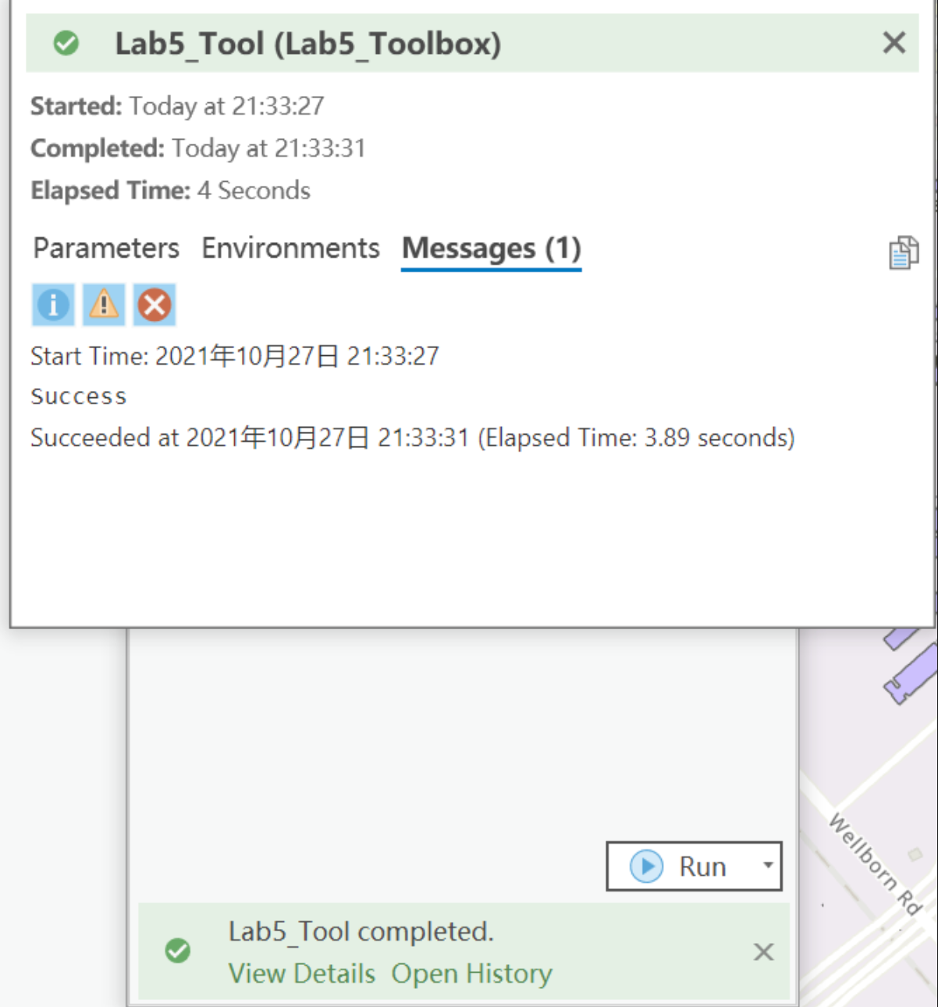
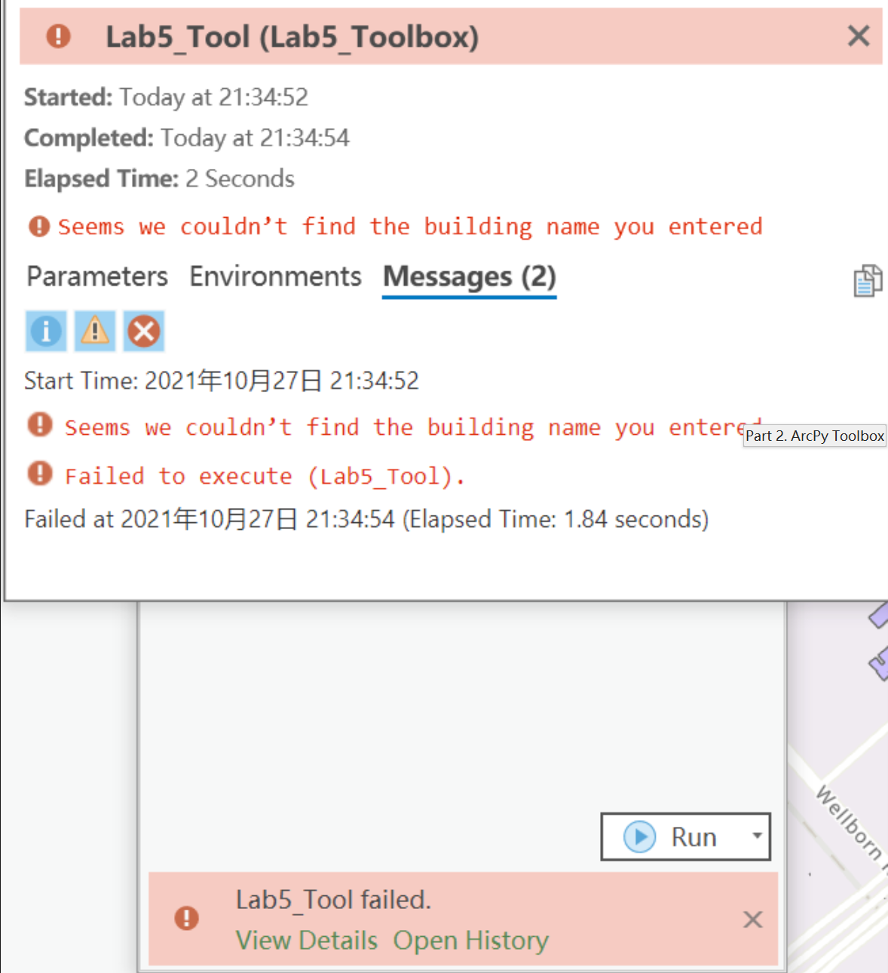
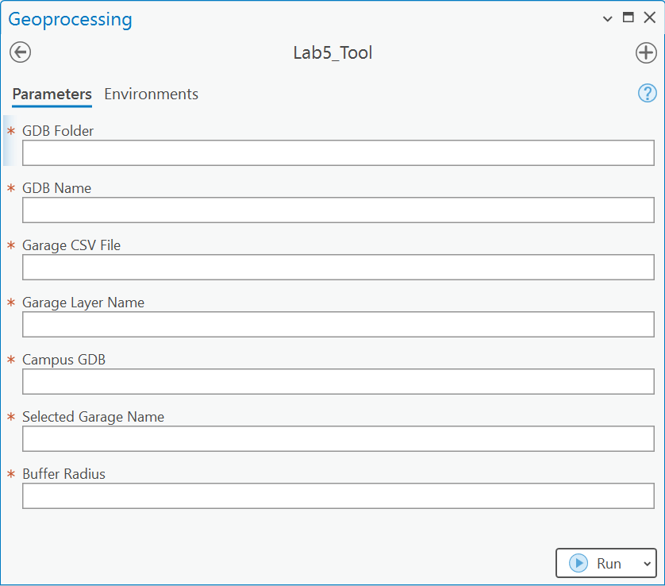
Part 2. ArcPy Toolbox
Results

Slide 14
Submission
A PDF file in 2 parts:
Tool Part
A screenshot of all your codes.
A screenshot of the running result in the terminal.
A screenshot of the output feature in ArcGIS Pro.
Toolbox Part
A screenshot of all your codes.
A screenshot of the toolbox interface in ArcGIS Pro.
Screenshots of the running details of the toolbox. Both the success and the error messages.
And your Github Link

Slide 15
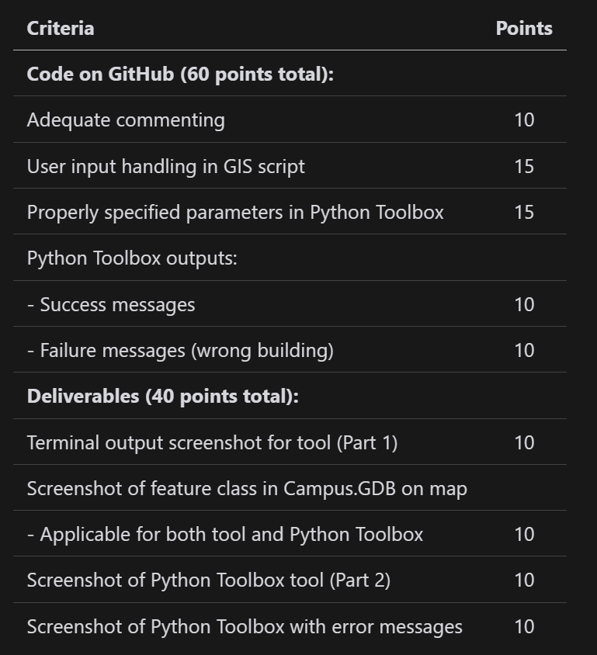
Grading Rule

Slide 16

Additional Resources
Useful Links
`Input()`
`arcpy.da.SearchCursor`
Arcgis parameter Docs
`arcpy.AddMessage`
VS Code Plugins
Python
Pylance
Python Debugger
Gitlens

Slide 17
The End

